Slide 1






CRYPTO TRADING ROBOT
by Iñigo Larrea Pombo

Slide 2




PROCESS
Investigation
Programming
Testing & Debugging

Slide 3

INVESTIGATION
BINANCE API
HOW TO PYTHON ?
COMMANDS ?
LIMITS ?

Slide 4

INVESTIGATION
TRADING
PREVIOUS KNOWLEDGE
BEST PRACTICES
ALGOTRADING

Slide 5
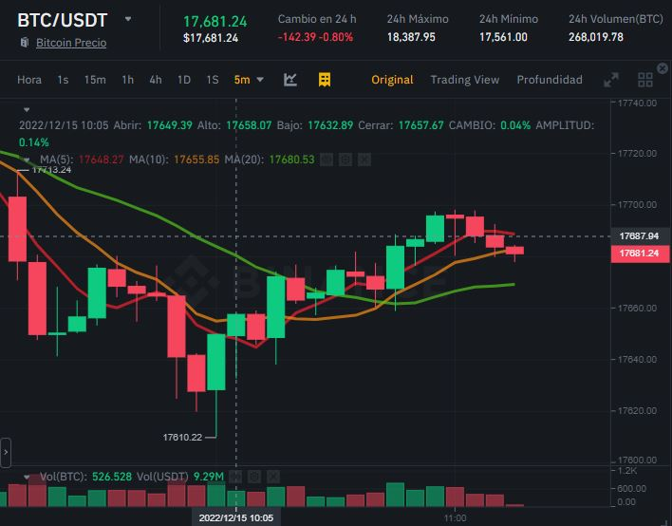
PROGRAMMING
FUNCTIONS
TREND
MOVING AVERAGES
QUANTITIES & PRICE FIT

Slide 6
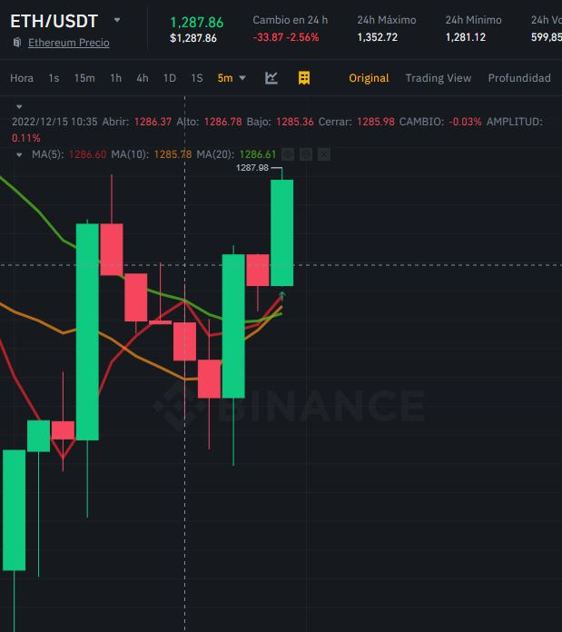
PROGRAMMING
CONDITIONS
PRICE > MA5 > MA10 > MA20
TREND POSITIVE
NO OPEN ORDERS ALREADY
Conditions met

Slide 7
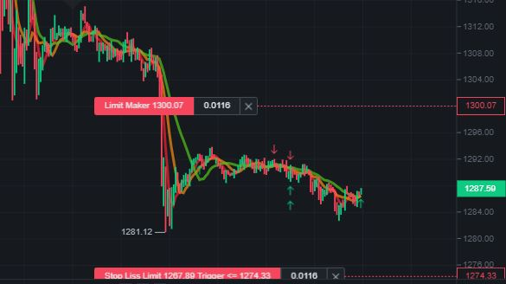
PROGRAMMING
OCO ORDER
STOP LOSS
TAKE PROFIT
ONE CANCELS OTHER (OCO)

Slide 8
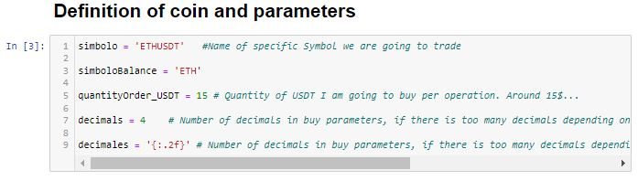
PROGRAMMING
UNIVERSAL BOT
MULTIPAIR
EASY CONFIG
USER FRIENDLY

Slide 9
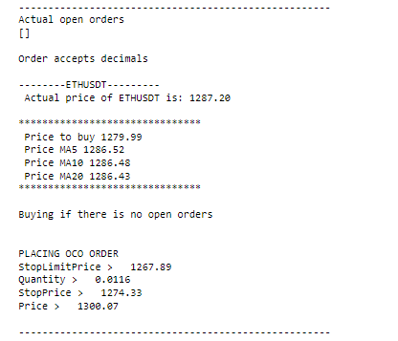
TEST & DEBUGGING
OUTPUT
LOOP DISPLAY
CLEAR INFO
REALTIME

Slide 10
TEST & DEBUGGING
ISSUES
FORMAT PRICE AND QUANTITY
EACH CRYPTO HAS DIFFERENT PARAMETERS
LAZY AND BEAR MARKET…

Slide 11

FUTURE
IMPROVEMENTS
OTHER EXCHANGES
RAW MATERIALS, FOREX, STOCKS
APP

Slide 12

Thank You

